Slide 1
Cloud Computing and Big Data Understanding Cloud Services
Oxford University
Software Engineering Programme
Sept 2017

Slide 2
Capabilities offered as-a-Service
Software-as-a-Service
Salesforce, Quickbooks Online, Gmail, Gdrive, Office 365, etc
Infrastructure-as-a-Service
CPUs, Memory, Disk, Networks, Firewalls, etc
Amazon AWS, Joyent, Microsoft Azure, IBM Softlayer, Rackspace, Google Compute Engine
Platform-as-a-Service
Somewhere between!

Slide 3
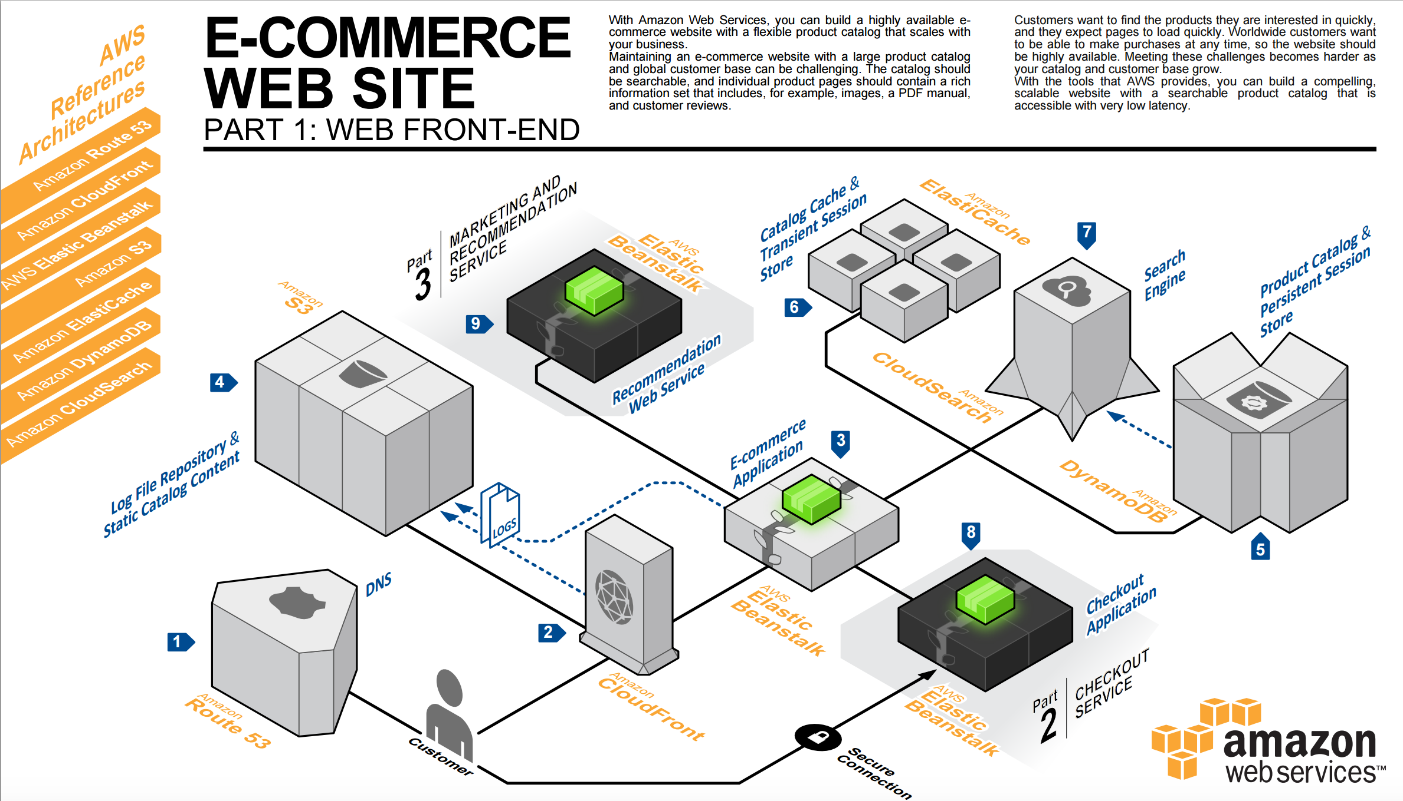

Slide 4
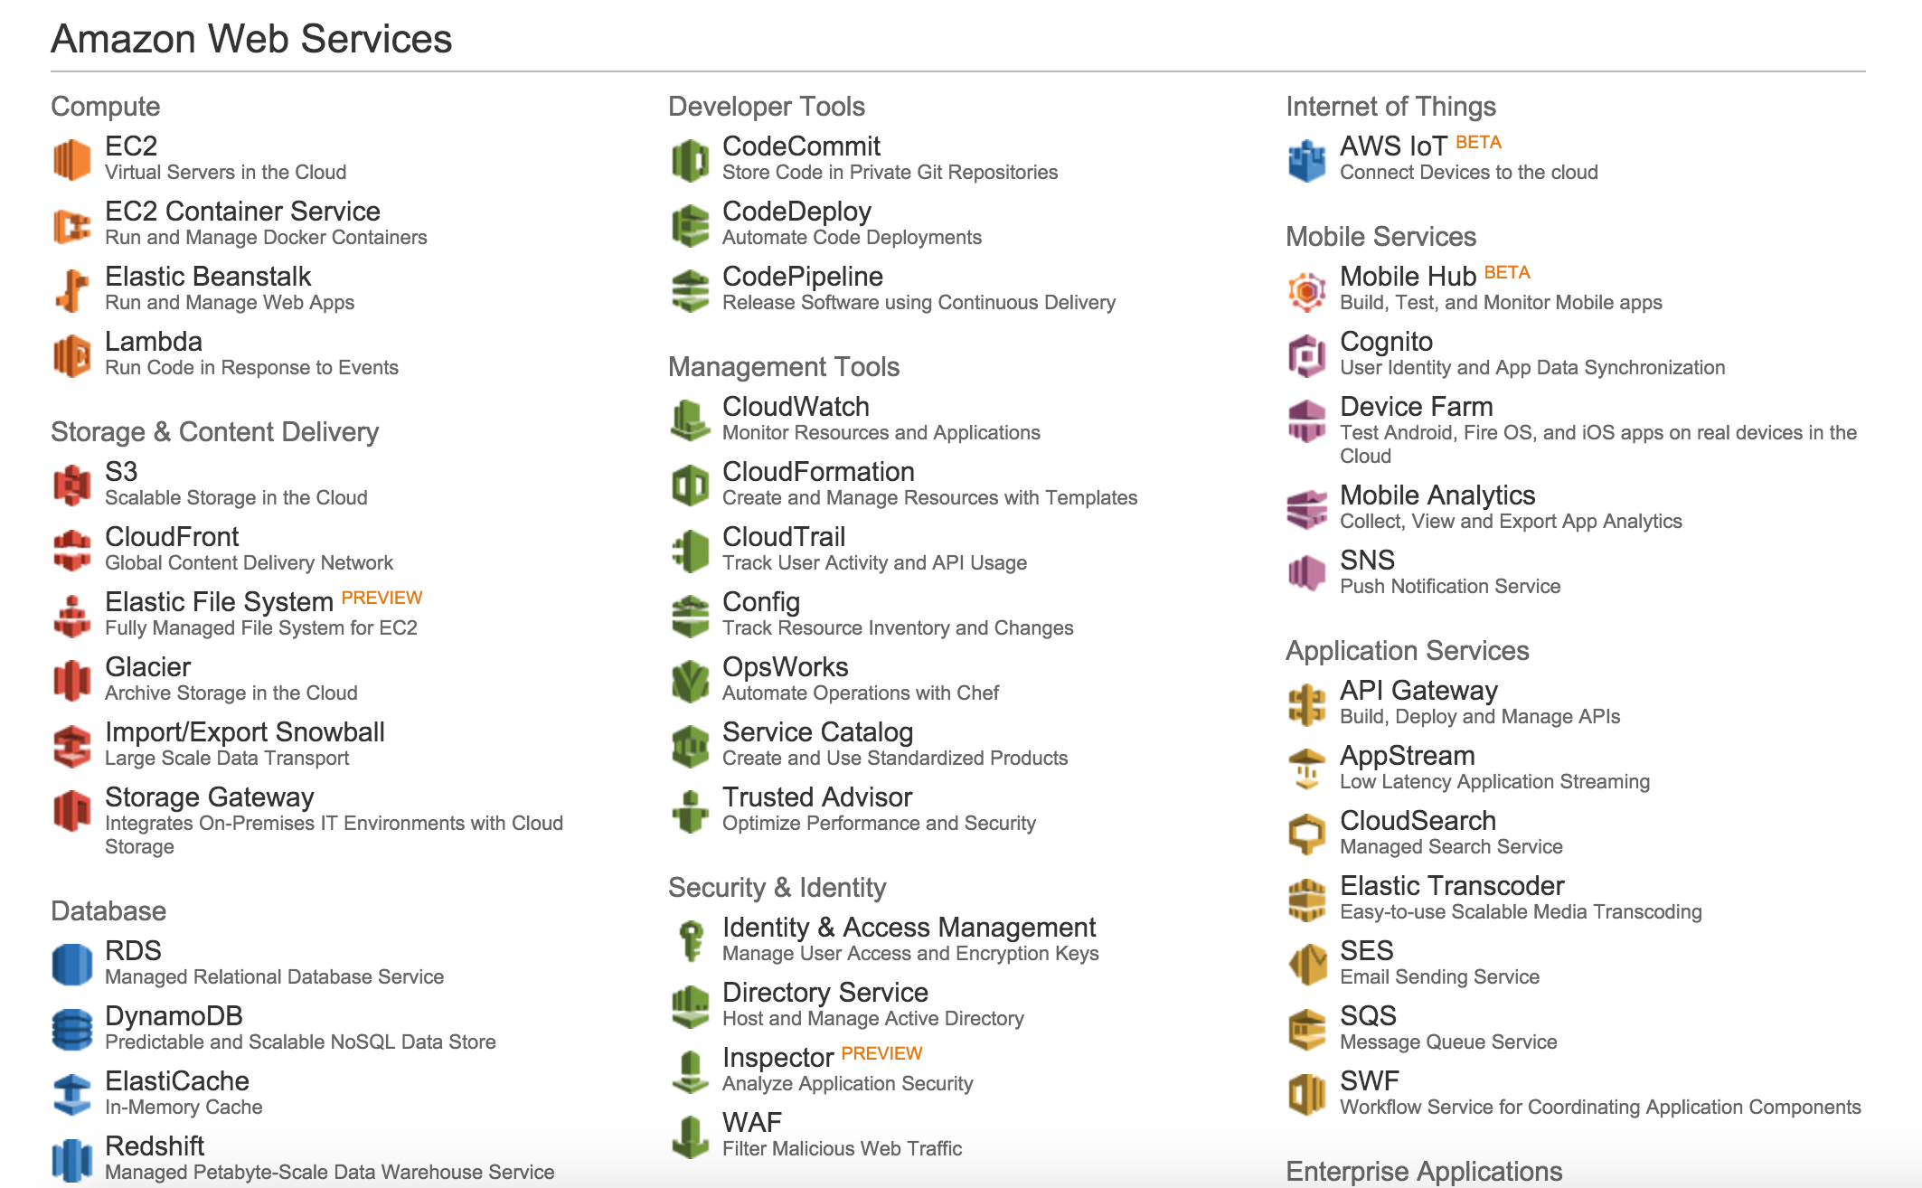
Infrastructure-as-a-Service

Slide 5
IaaS, PaaS, SaaS
Software as a Service
Platform as a Service
Dev Ops
Custom-ization
Infrastructure as a Service

Slide 6
Public IaaS
Main Infrastructure-as-a-Service options:
Amazon AWS (largest market share)
Google GCE
Microsoft Azure
IBM Softlayer
Rackspace
Joyent
DigitalOcean

Slide 7
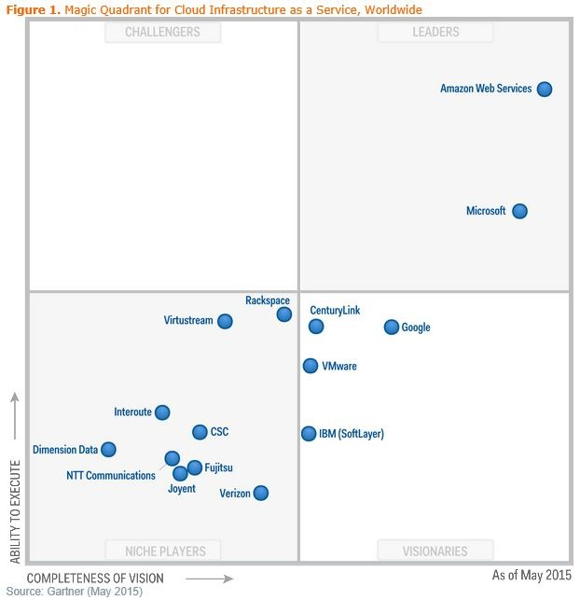
Gartner’s view

Slide 8
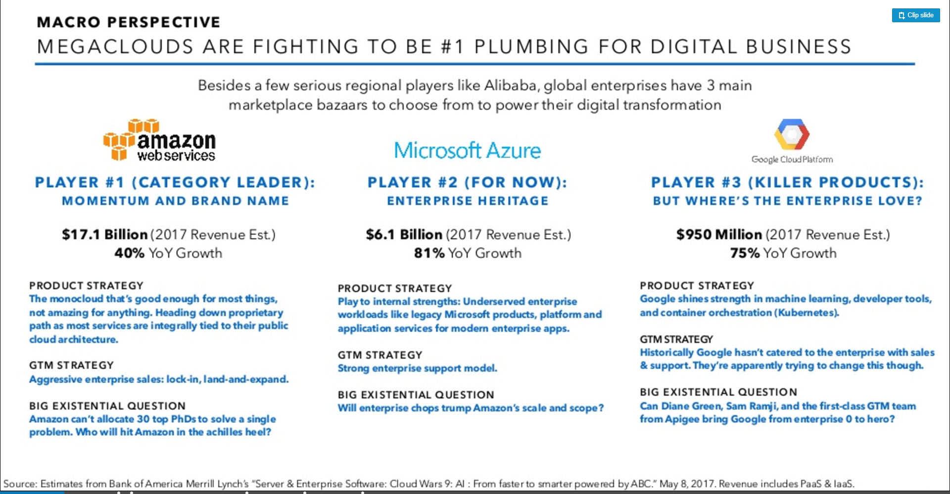

Slide 9
Private IaaS
OpenStack
HP Enterprise Eucalyptus
vmWare vSphere / vCloud
Apache CloudStack

Slide 10

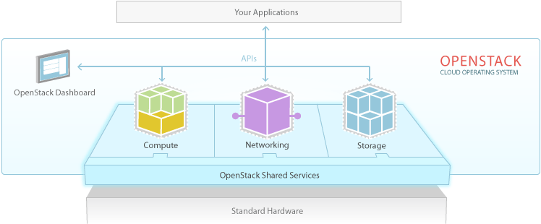
OpenStack
Compute - Nova
Networking - Neutron (formerly Quantum)
Block Storage – Cinder
Object Storage – Swift
Image Service – Glance
Identity Service - Keystone

Slide 11
EC2 / AWS main functions
EC2 (Elastic Compute Cloud)
Instances
Servers of various sizes
AMIs (Amazon Machine Images)
Server images
Elastic Block Storage (EBS)
Virtualized Hard drives
VPC (Virtual Private Cloud)
Secure network space
S3 (Simple Storage Solution)
“Buckets” of data
Longer term storage of data

Slide 12
Platform-as-a-Service PaaS
IaaS is about provisioning
machines, disk, network
PaaS is about provisioning services for developers
Hadoop, Spark, JEE containers
Databases, Queues, Pub/Sub
Cache, Email services, Notifications
Sort of SaaS for developers

Slide 13
Public PaaS options
Amazon AWS is becoming a PaaS
RDS (Database), DynamoDB
ElastiCache (memcache as a service)
Elastic Beanstalk (deployment as a service)
Simple Notification Service
API Gateway
CloudSearch
Etc, etc, etc!

Slide 14
Other Public PaaS options
Google App Engine
Force.com App Cloud
Heroku
IBM Bluemix
RedHat OpenShift

Slide 15
Private PaaS options
Pivotal CloudFoundry
The market leader
Redhat OpenShift

Slide 16
Serverless
Invisible infrastructure
Not yet clearly defined, but centering around the concept of Function-as-a-Service
E.g. AWS Lambda
Deploy a function that is fired when an event happens

Slide 17
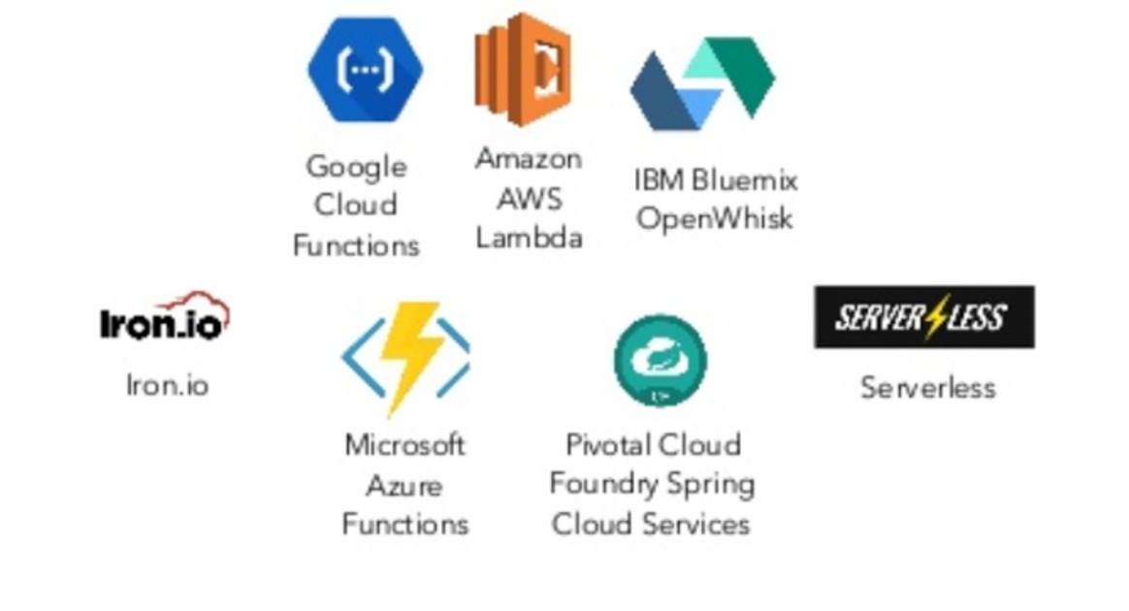
Serverless = Functional pipelines

Slide 18
Amazon Lambda
Serverless computing
Runs a small amount of code in response to an event
Billed in increments of 100 ms
Really pay as you go
Scalable (you don’t need to define servers)

Slide 19
Back to Amazon AWS
Three ways to interact
Amazon Dashboard (web)
APIs and Command-Line
Third-party tools
ElasticFox, HybridFox
Scalr

Slide 20
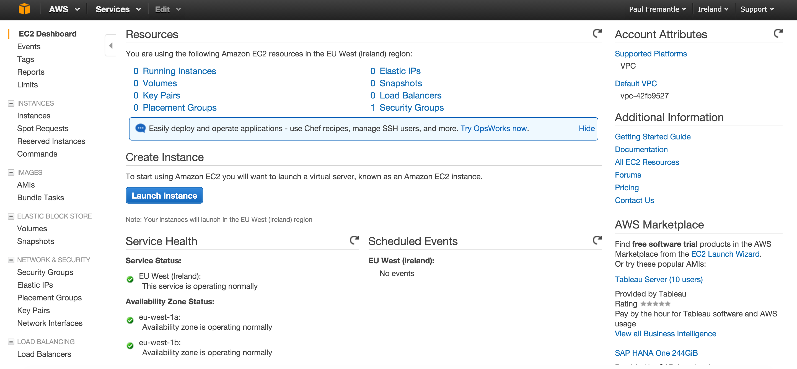
Amazon EC2 Dashboard

Slide 21
Amazon EC2 demo

Slide 22
Main EC2 components
Instances
Your virtual computers
Volumes (EBS)
Disk drives
Elastic IPs
Specific IP address that can be assigned to systems
Security Groups
Sets of firewall rules

Slide 23
More components
Virtual Private Cloud (VPC)
A secure subnet for your instances which can be VPNed to/from your own datacentre
Includes/requires an Internet Gateway for creating public services
Load Balancers
Network load-balancing system
Key pairs
Security tokens for managing access
Route 53
Amazon’s DNS system

Slide 24
Other cool AWS stuff
AWS IoT management
Code tools
Management
Analytics
API Gateway
Machine Learning

Slide 25
Important
There is a difference between stopping an instance and terminating
Stopping
Your instance is stopped, but the disk is still allocated
You will be charged for EBS disk
Terminating
Disk will also be removed and you will not be charged

Slide 26
EC2 machine sizes
Families
T2, M4, M3, C4, C3, R3, G2, I2, D2
General purpose – T, M
Compute – C
Memory – R
GPU – G
IO – I
Data – D
Numbers indicate the “family version”
E.g M4 supercedes M3

Slide 27
Amazon instance types (subset)
Instance Type | vCPU | Memory | Storage | Networking Performance | Physical Processor | Clock Speed | EBS OPT | Enhance Networking
t2.micro | 1 | 1 | EBS Only | Low to Moderate | Xeon family | Up to 3.3 | - | -
t2.large | 2 | 8 | EBS Only | Low to Moderate | Xeon family | Up to 3.0 | - | -
m4.large | 2 | 8 | EBS Only | Moderate | Xeon E5-2676 v3 | 2.4 | Yes | Yes
m4.10xlarge | 40 | 160 | EBS Only | 10 Gigabit | Xeon E5-2676 v3 | 2.4 | Yes | Yes
c4.large | 2 | 3.75 | EBS Only | Moderate | Xeon E5-2666 v3 | 2.9 | Yes | Yes
c4.8xlarge | 36 | 60 | EBS Only | 10 Gigabit | Xeon E5-2666 v3 | 2.9 | Yes | Yes
g2.2xlarge | 8 | 15 | 1 x 60 SSD | High | Xeon E5-2670 | 2.6 | Yes | -
g2.8xlarge | 32 | 60 | 2 x 120 SSD | 10 Gigabit | Xeon E5-2670 | 2.6 | - | -
r3.large | 2 | 15.25 | 1 x 32 SSD | Moderate | Xeon E5-2670 v2 | 2.5 | - | Yes
r3.8xlarge | 32 | 244 | 2 x 320 SSD | 10 Gigabit | Xeon E5-2670 v2 | 2.5 | - | Yes
i2.xlarge | 4 | 30.5 | 1 x 800 SSD | Moderate | Xeon E5-2670 v2 | 2.5 | Yes | Yes
i2.4xlarge | 16 | 122 | 4 x 800 SSD | High | Xeon E5-2670 v2 | 2.5 | Yes | Yes
i2.8xlarge | 32 | 244 | 8 x 800 SSD | 10 Gigabit | Xeon E5-2670 v2 | 2.5 | - | Yes
d2.xlarge | 4 | 30.5 | 3 x 2000 | Moderate | Xeon E5-2676 v3 | 2.4 | Yes | Yes
d2.8xlarge | 36 | 244 | 24 x 2000 | 10 Gigabit | Xeon E5-2676 v3 | 2.4 | Yes | Yes

Slide 28
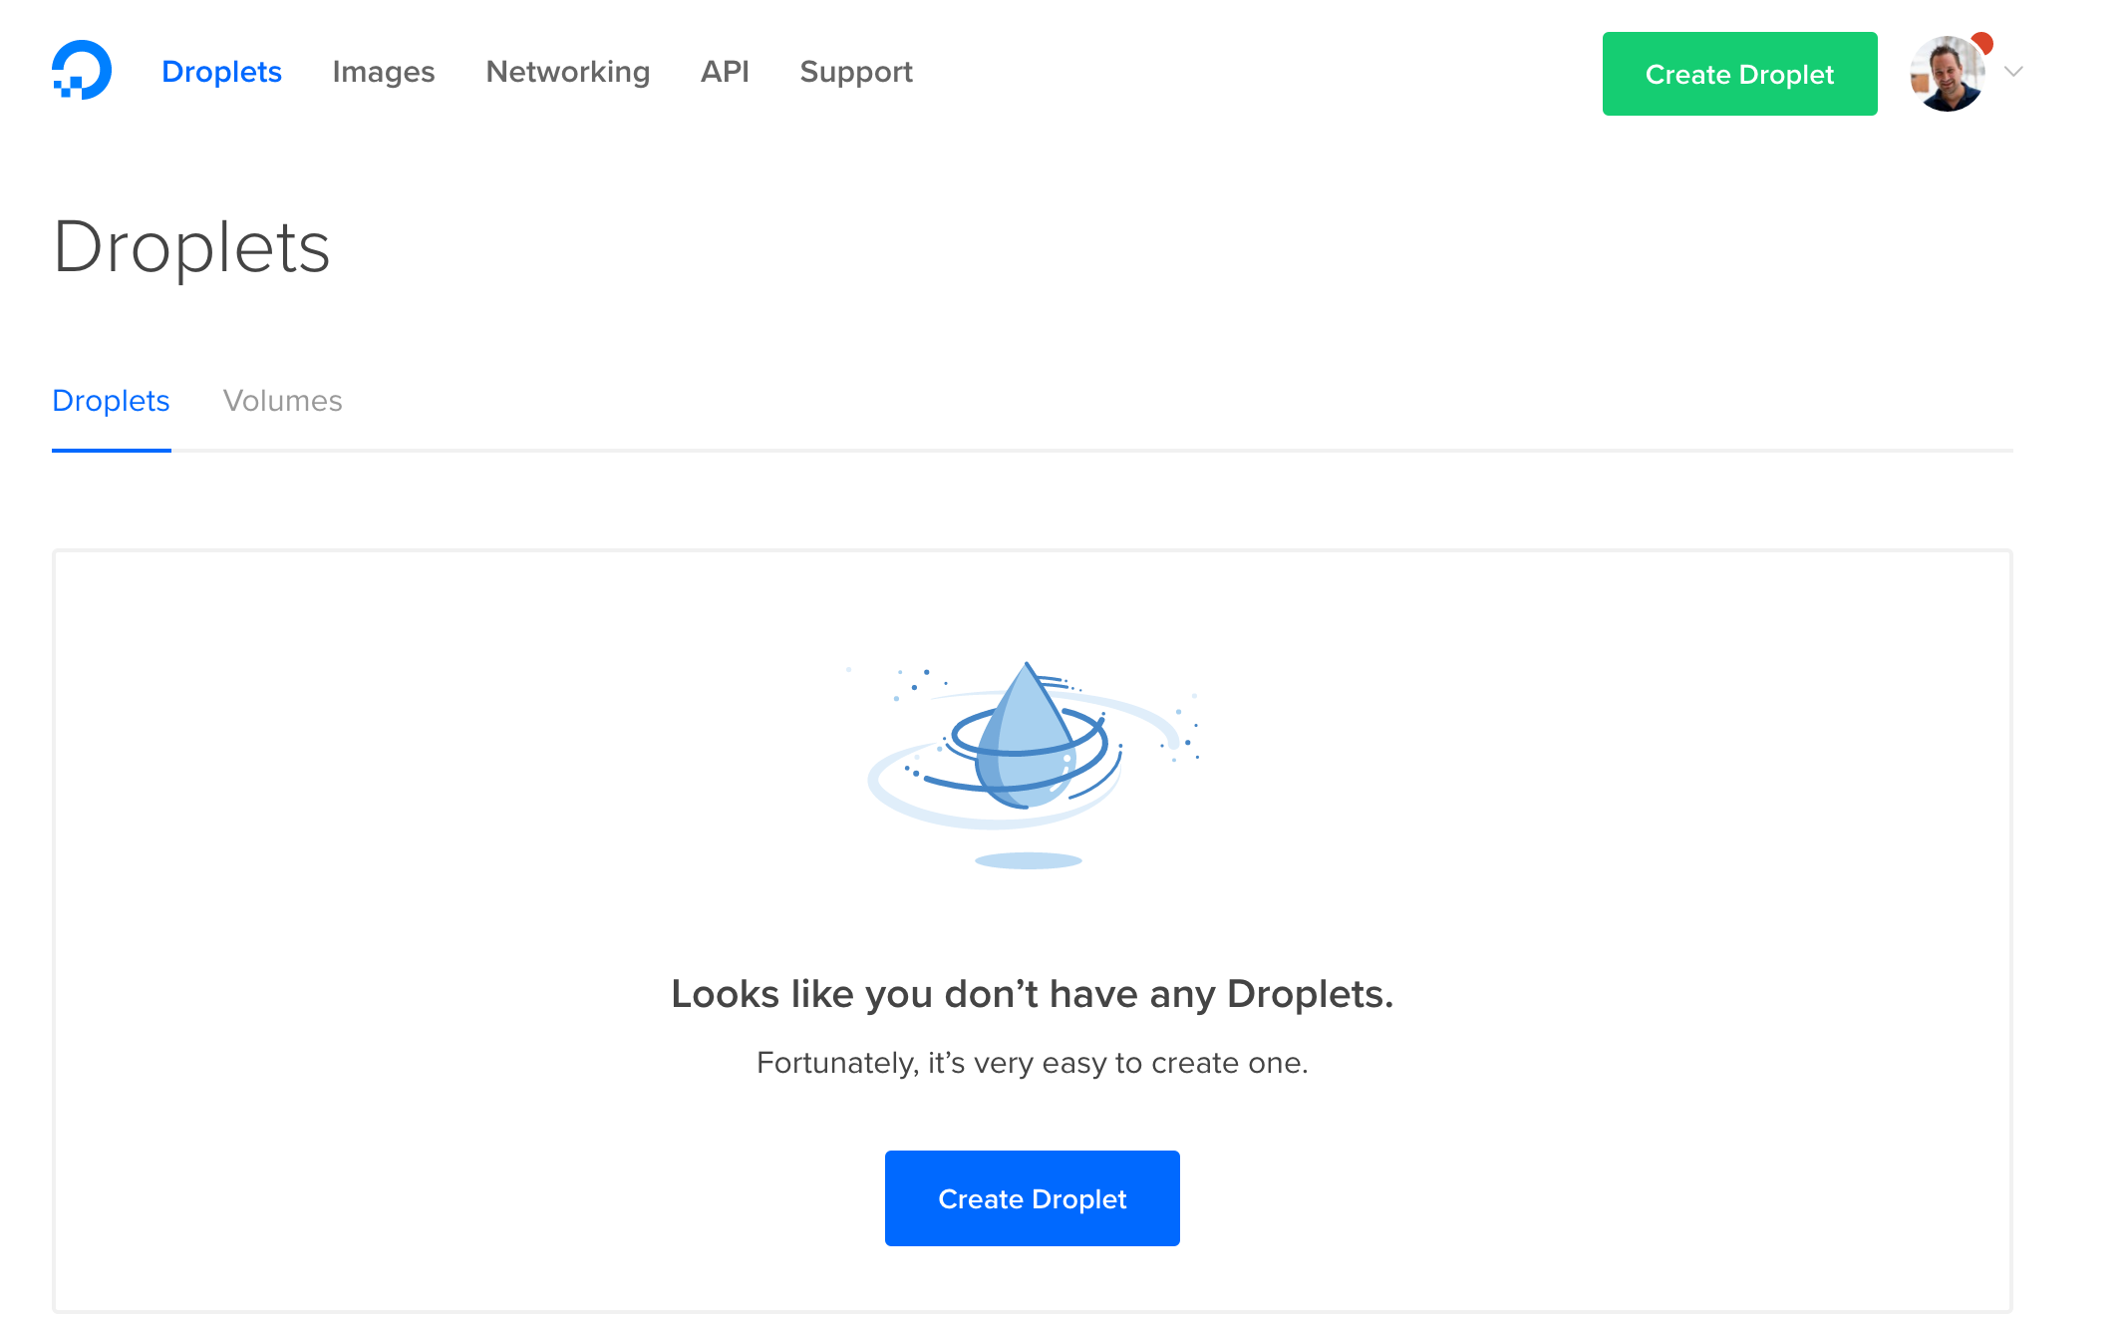
An alternative – DigitalOcean

Slide 29
Other alternatives
Microsoft Azure
Very strong brand around Microsoft toolkit
IBM Softlayer
Many others

Slide 30
Summary
SaaS/PaaS/IaaS
IaaS providers
PaaS providers
Working with AWS / EC2
Now to do a lab!

